Slide 1


Building Partnerships for Engaged Decision Support:
A Vision
of Institutional Research
at an R1 University
Stephen Chemsak, Ed.D.
Notes:
Great relationships and partnerships create opportunities and drive good decision support and good decision making.

Slide 2
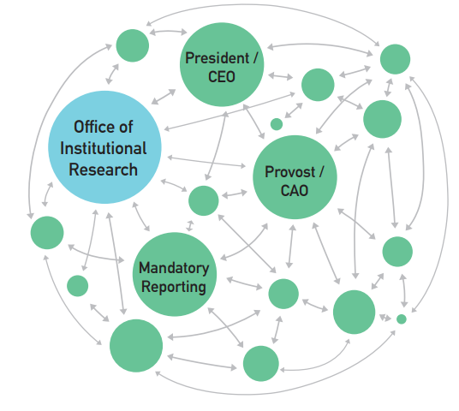
A New Vision for Institutional Research
Swing and Ross, 2016
Notes:
Move beyond the research, look at the process.

Slide 3
Insights from…
10+ years in IR across sectors (public and private higher education).
5+ years, each, at each IR Director (about 6 years) and IR Asst. Dir. Levels, working with Deans, VPs, Registrars, Presidents, IT, Admissions, HR, etc.
9+ IR colleagues supervised including associate director, 2 PhDs, analysts.
Notes:
Columbia University
Process important in my experience.

Slide 4
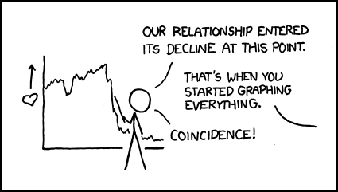

Slide 5
IR Challenges
X IR trained in social science. But IR requires data science, qualitative research, soft skills.
X Not engaged in decision support and self-assessment due to data cleaning and reporting. Not focused on students, faculty, administration needs.
X Not good at communicating results. IR does produce great results, but needs to share better. IR likes numbers, but they can’t tell whole story.

Slide 6



Solution: A Vision of Institutional Research at an R1 University
Director models and builds relationship with team through professional development, creating capacity for cross-campus projects.
Director engages in IR team with cross-campus projects, first encouraging “traditional” projects to build partnerships, then moves to empower external stakeholders in decision support, ever asking for feedback to improve.
IR office increases partners’ engagement more by incorporating qualitative research to address “why” questions and communicate stories of value-added through project lists, annual reports, and presentations.
Notes:
Other ways to build partnerships

Slide 7
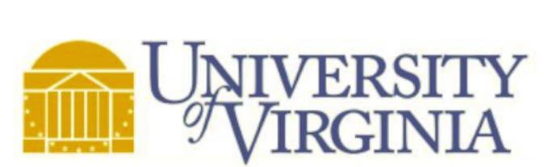
A Plan: Measure Research Impact
Initial engagement and development to engineer data collection system.
Scenarios empowering partners to makes decisions.
“Tracking and Forecasting the Impact of Strategic Investments in Research Across Arts and Sciences”, 2018
Stories of impact proposed in rich, multimedia format.

Slide 8
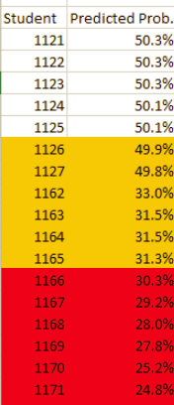

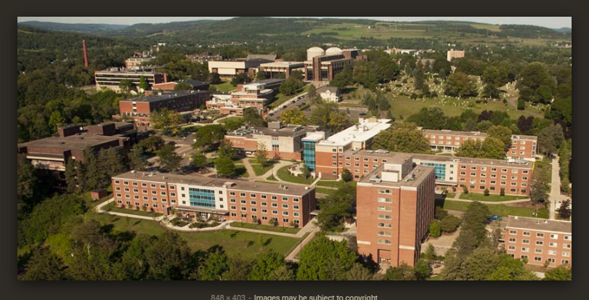
A Project: List of Probability Students Return, 2016
Master’s level includes 6,300 undergrads in 250,000 SUNY system.

Slide 9
Building Partnerships for Engaged Decision Support:
A Vision
of Institutional Research
at an R1 University
Notes:
Great relationships and partnerships create opportunities and drive good decision support.
There is no single metric.

